Slide 1

EXPANDING THE APPLICATION OF RECYCLED CONCRETE AGGREGATES FOR ROAD CONSTRUCTION
Dr. Ahmed SOLIMAN Ph.D., P.Eng. (ON).
Associate Professor, Building Civil and Environmental Engineering Department
March 31St, 2025

Slide 2



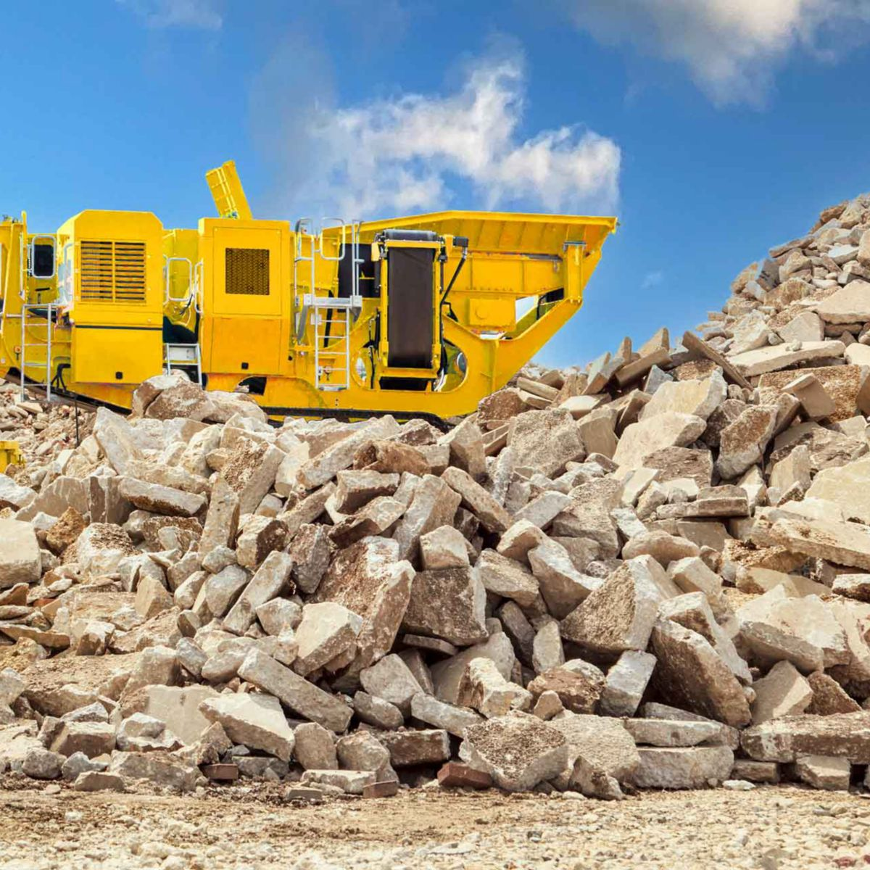
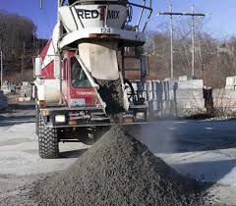

Recycled Concrete Aggregate
Demolition of Concrete Structure
Returned Concrete

Slide 3
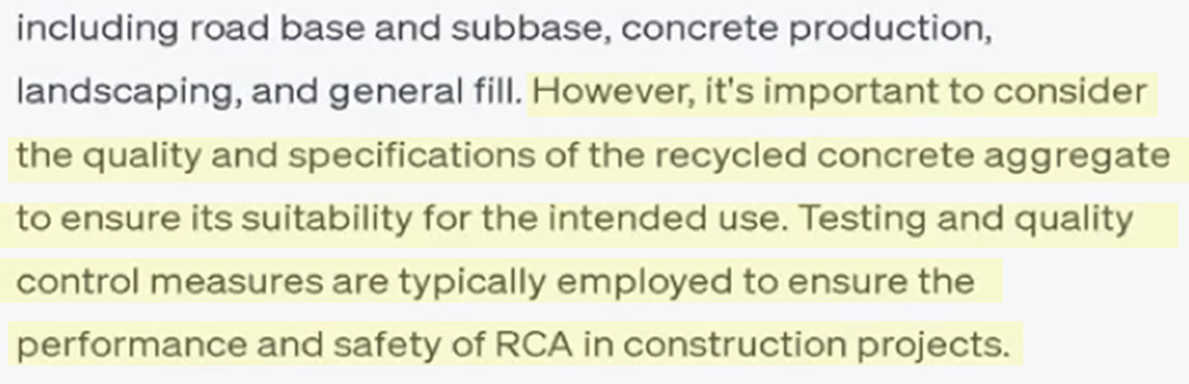
Recycled Concrete Aggregate
Demolition of Concrete Structure
Returned Concrete

Slide 4


Recycled Concrete Aggregate

Slide 5
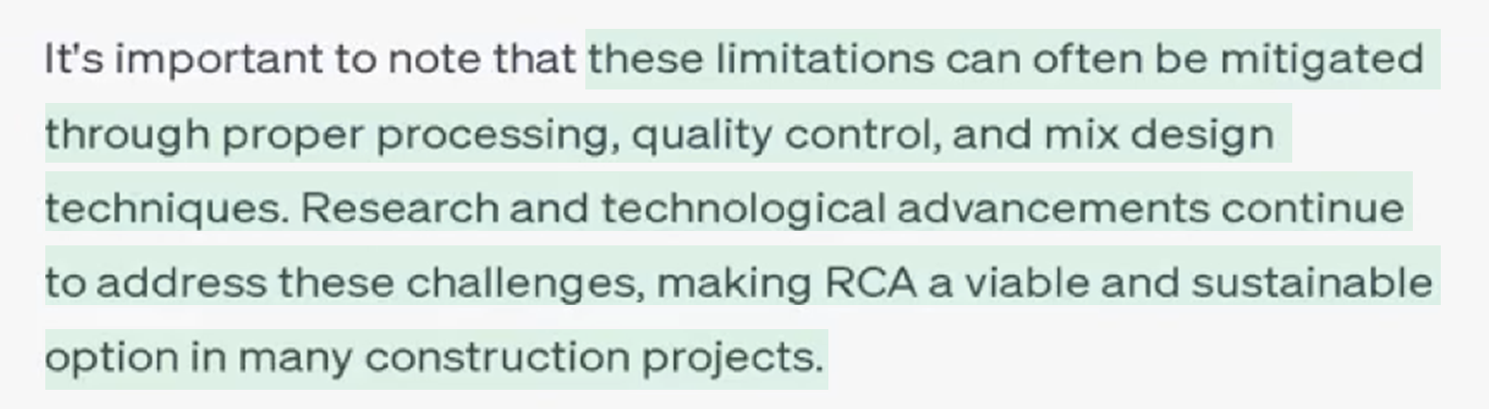
Recycled Concrete Aggregate

Slide 6
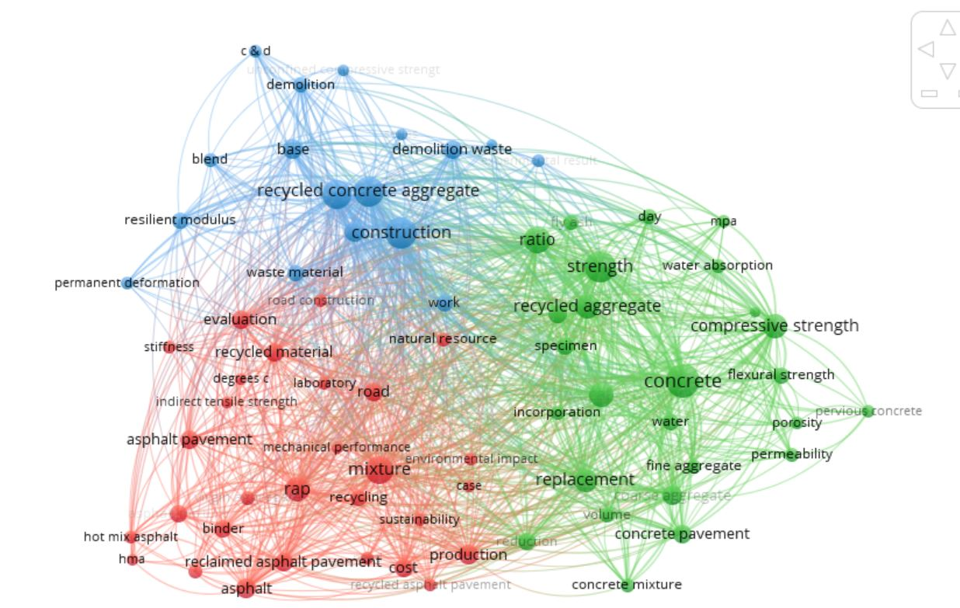
Bibliometric analysis of RCA Research
Construction practices and resource management
Material properties and characterization
Engineering applications and performance metrics

Slide 7
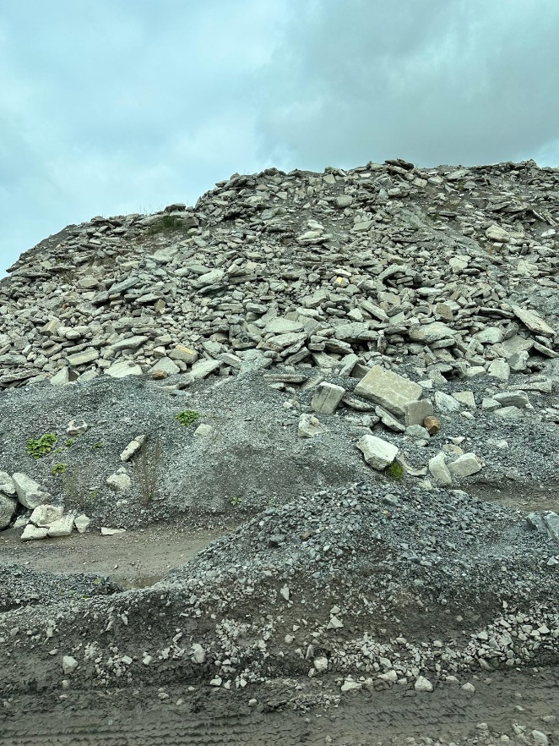
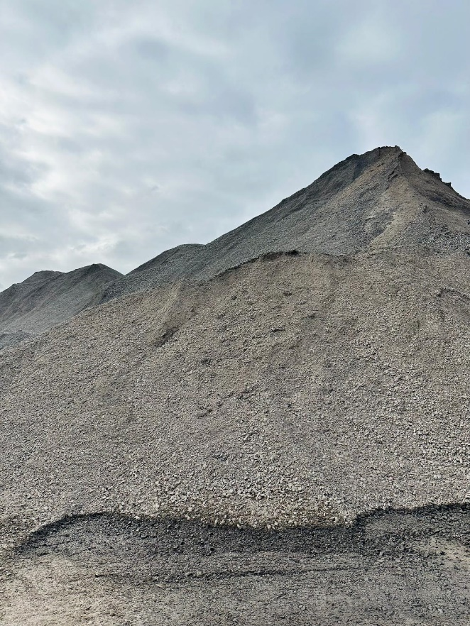
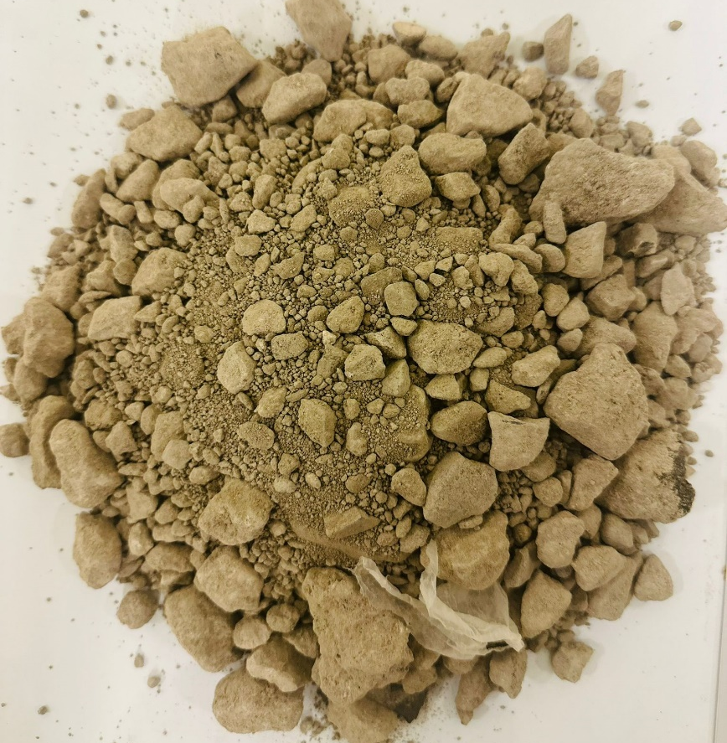
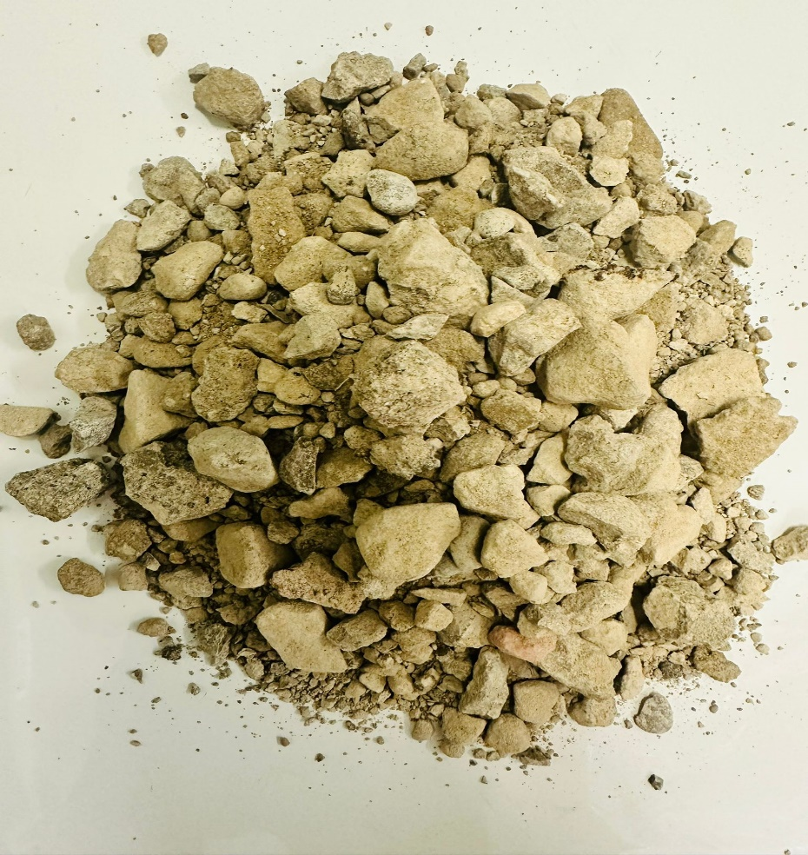
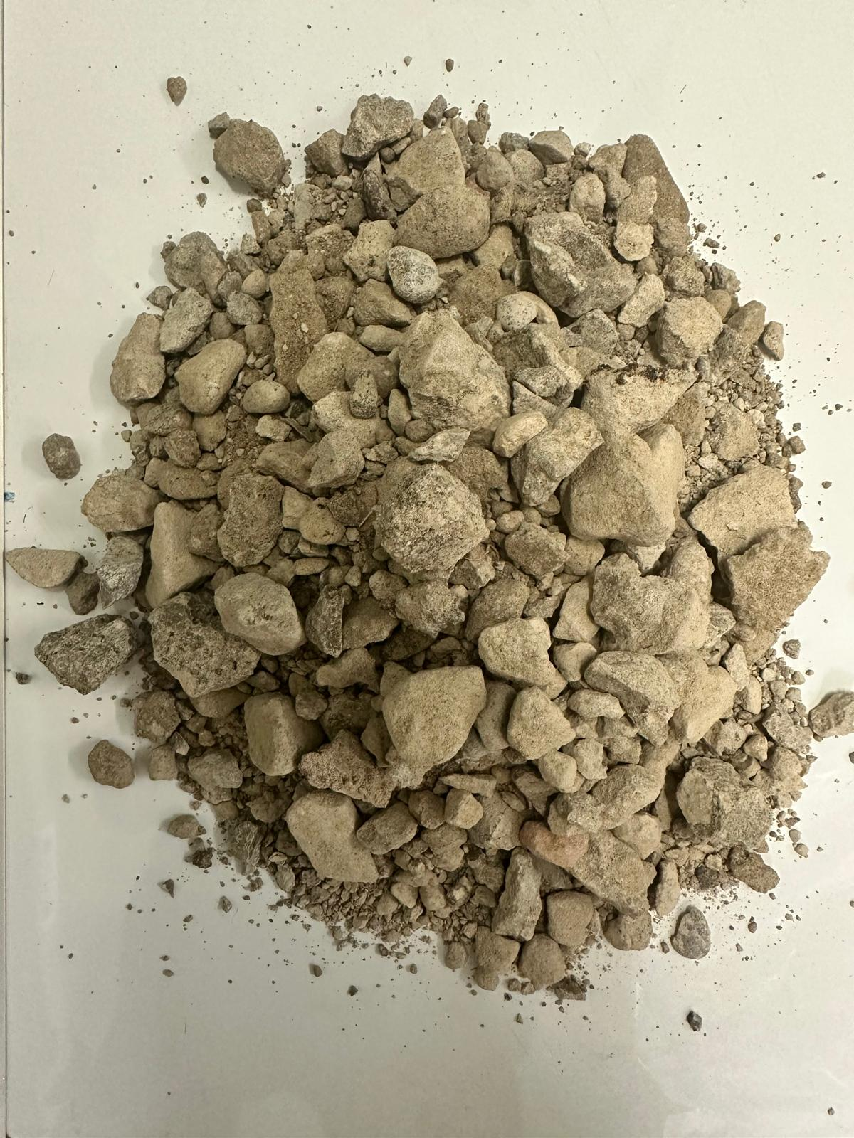
Sampling RCA
 | Size range | Source description | Status
RCA 1 | 0 – 20 | Demolition Concrete and Ready-Mix Returns | TREATED
RCA 2 | 0 – 50
RCA 3 | 0 – 31.5 | Bridge, culvert, concrete structure
RCA 4 | 0 – 56
RCA 5 | 0 – 31.5 | Sidewalk and sub-pavement slab
RCA 6 | 0 – 50 | Demolition Concrete and Ready-Mix Returns | Not TREATED
Untreated RCA
Treated RCA

Slide 8
Research Work
Technical Evaluation
Survey
Physical Properties
Visual Inspection
Sieve Analysis
Specific Gravity
Water Absorption
Bulk Density
Durability Test
Micro Deval
Washing Cycles Analysis
Infiltration Rate
Key Aspects
Knowledge and Awareness
Current Practices
Implementation Barriers
Environmental Impact
Analysis Focus
Acceptance level
Implementation Challenges
Industry Recommendation
Future Implementation Strategies

Slide 9
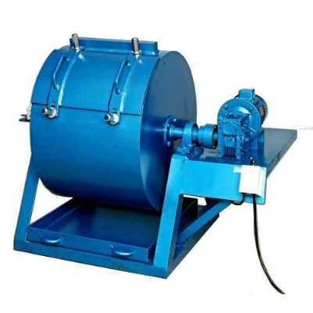
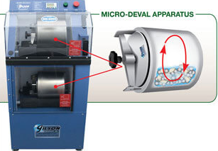
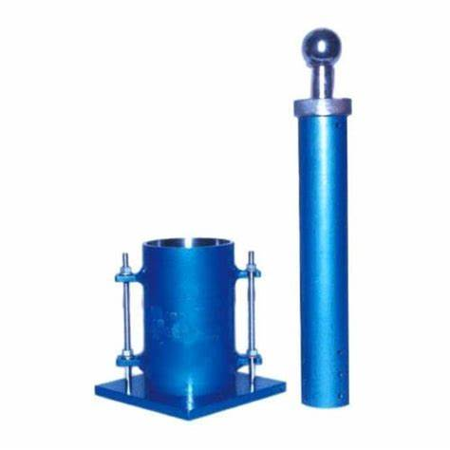
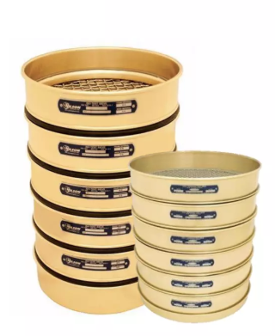
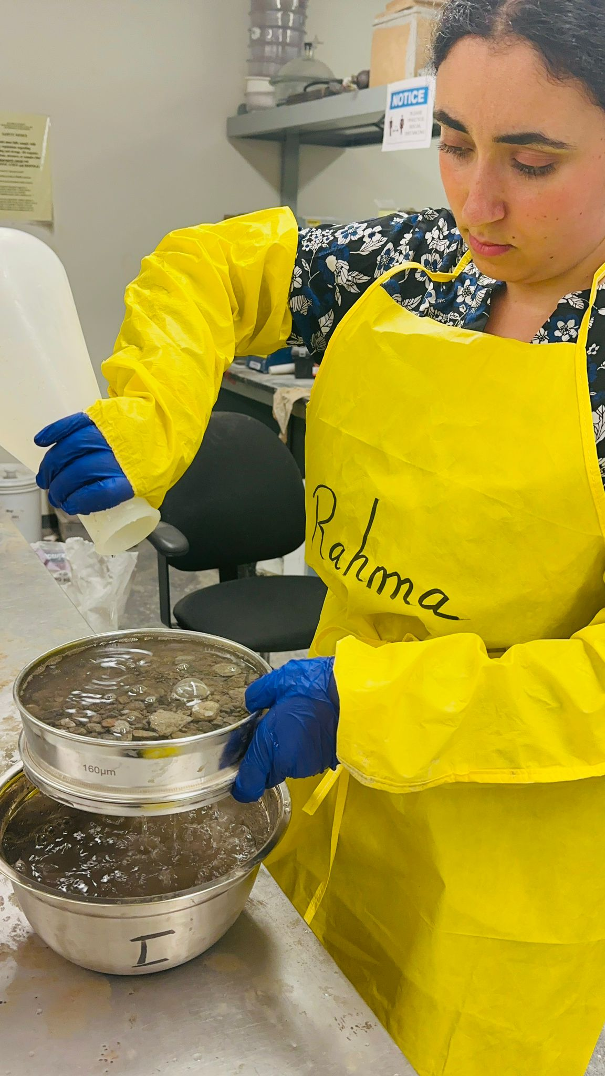
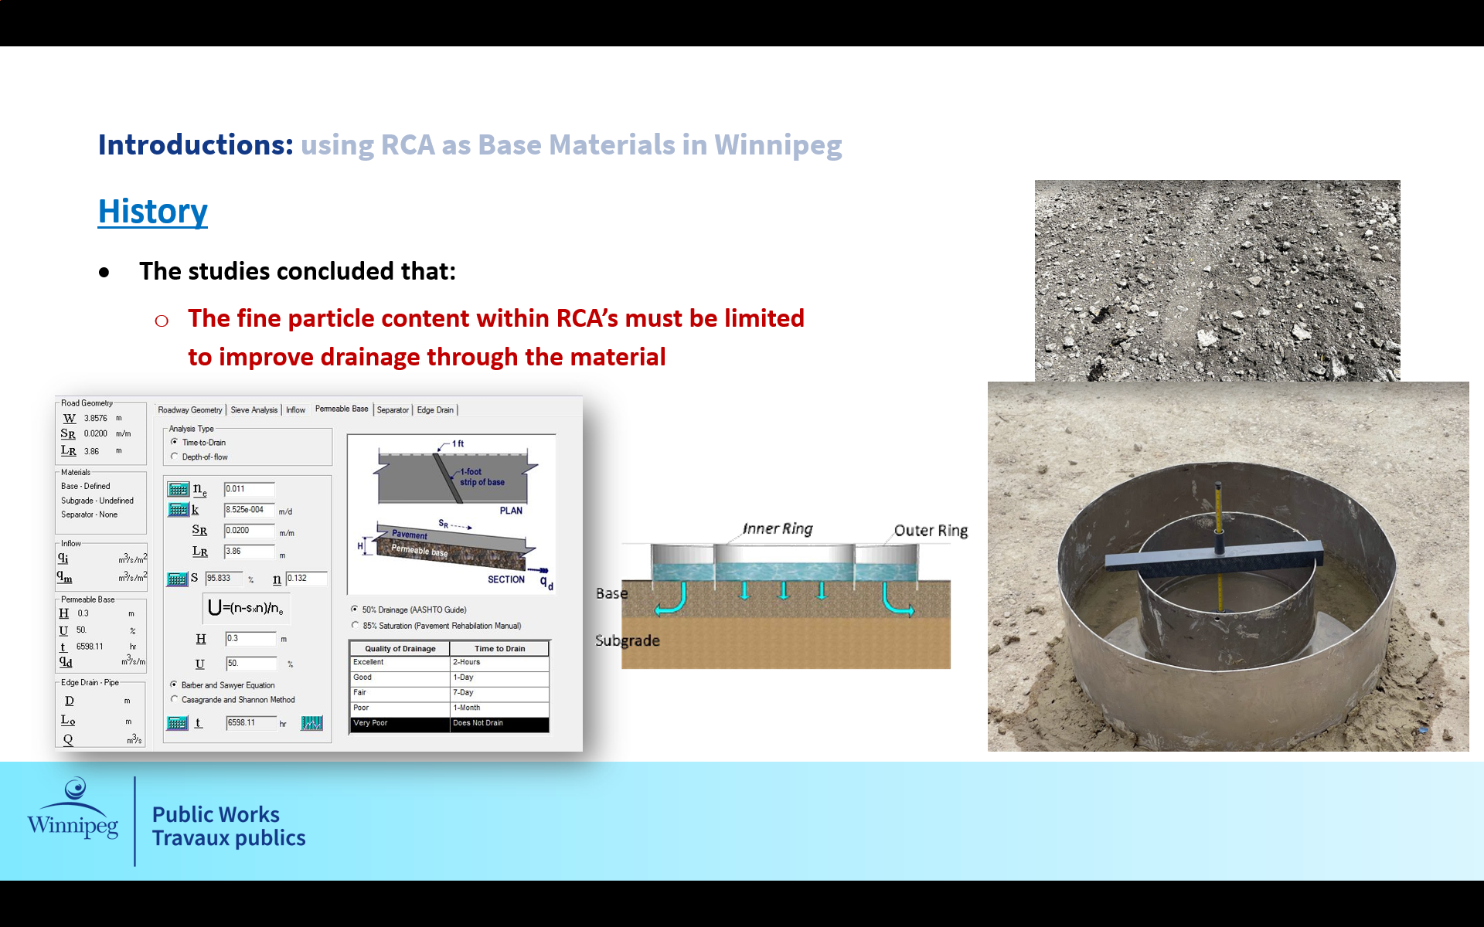
Research Work
Los Angelos Abrasion Test
Technical Evaluation
Physical Properties
Visual Inspection
Sieve Analysis
Specific Gravity
Water Absorption
Bulk Density
Durability Test
Micro Deval
Washing Cycles Analysis
Infiltration Rate
Standard Proctor Test
Sieve Analysis
Washing Cycles
Infiltration Rate

Slide 10
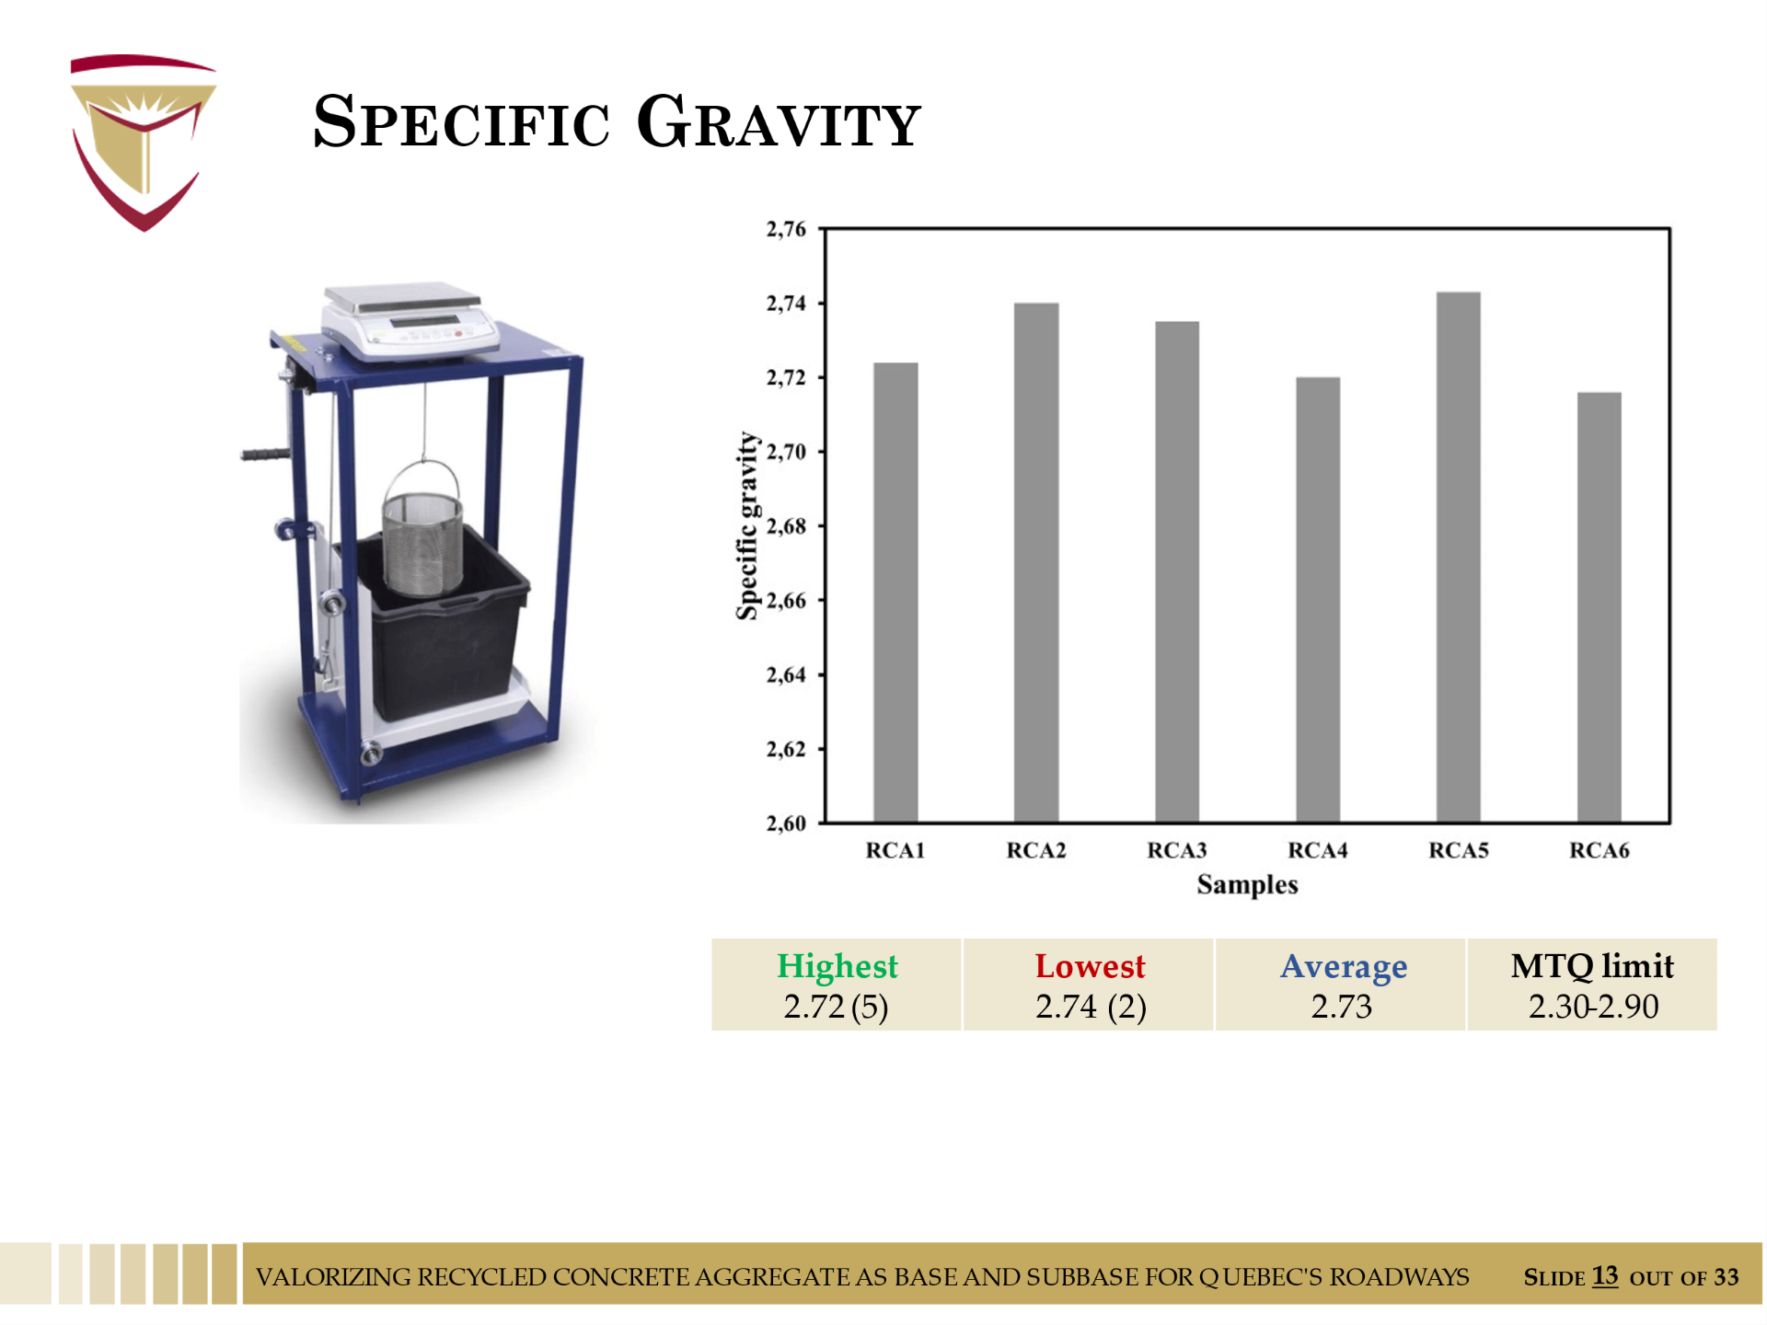
The treated recycled concrete aggregate had an acceptable Specific Gravity
N.A.≈ 2.75
RCA: 2.4-2.5

Slide 11
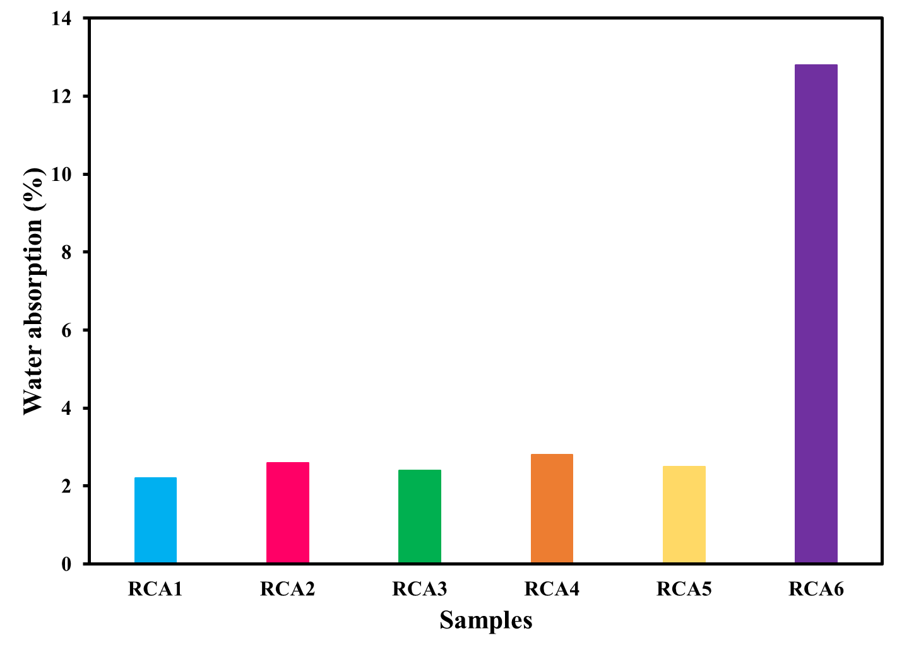
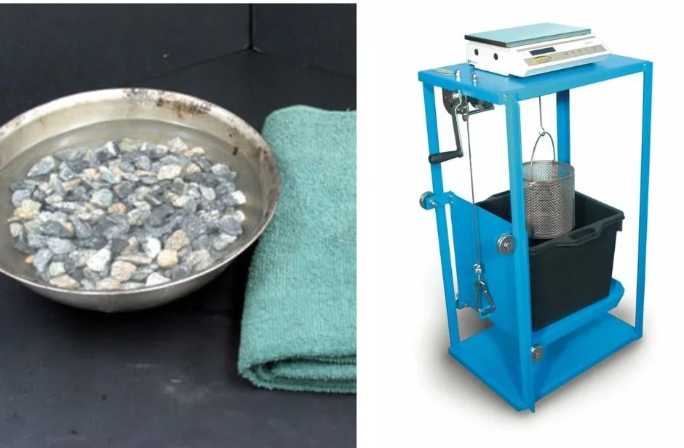
The treated recycled concrete aggregate showed a significantly lower water absorption
Limit: 3%-10%
2.1%-2.7%
Water Absorption Test of Aggregate: Lab Procedure, Result and Precautions - Dream Civil
N.A.≈ 1% (5%)

Slide 12
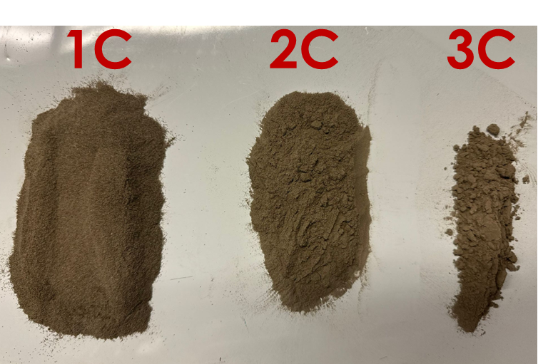
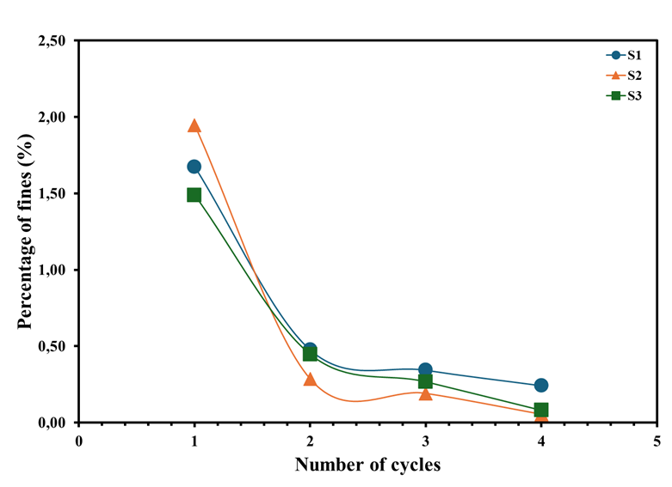
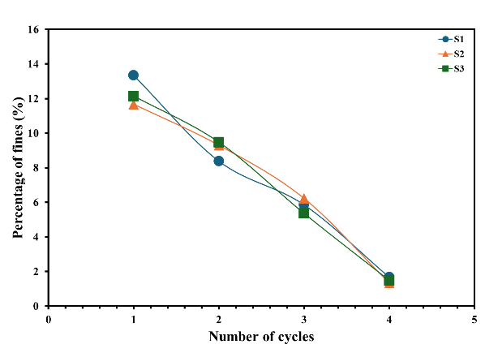
The Treatment process reduces the initial quantity of fine particles included in RCA from 14% to 2%
Treated RCA
Untreated RCA
ASTM C117 Standard Test Method for Materials Finer than 75-μm (No. 200) Sieve in Mineral Aggregates by Washing

Slide 13
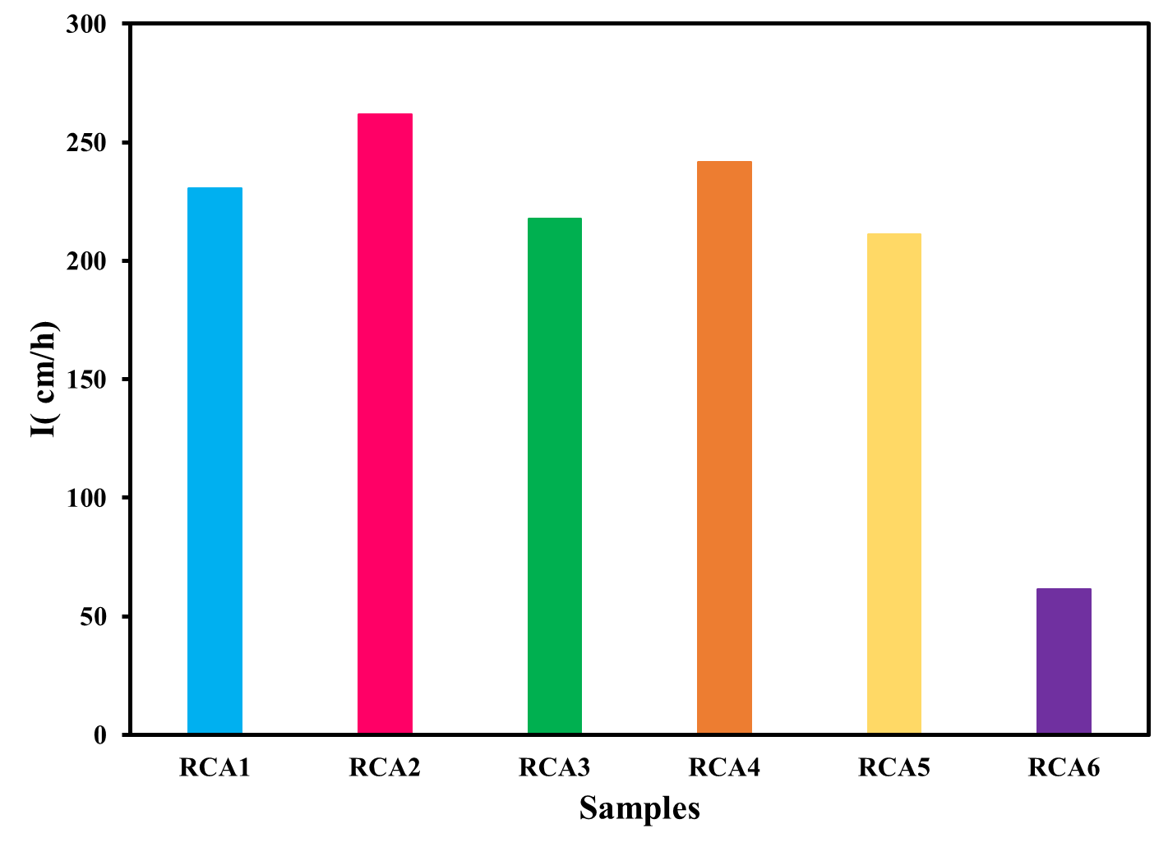
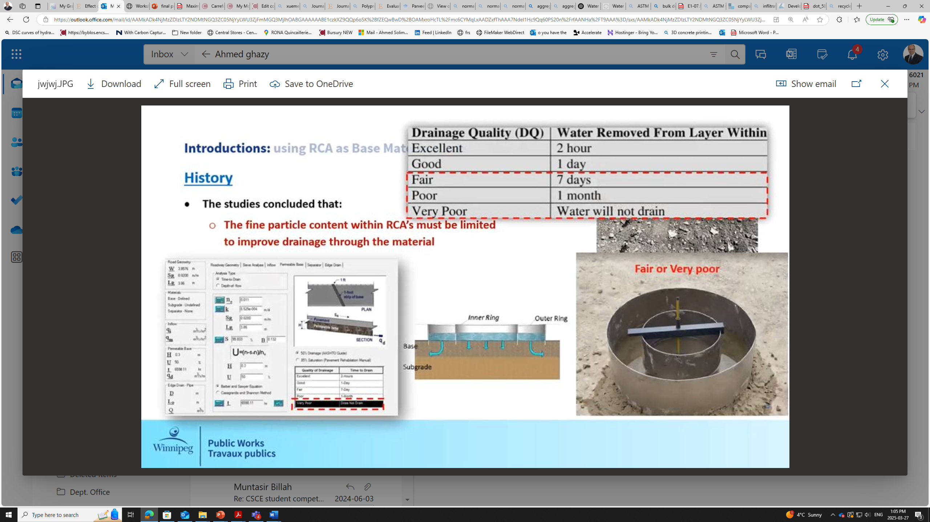

Drainability is a significant consideration in roadway base materials
Increased pore water pressure
Reduction of strength/stiffness
Freeze-thaw damage
Treated RCA

Slide 14
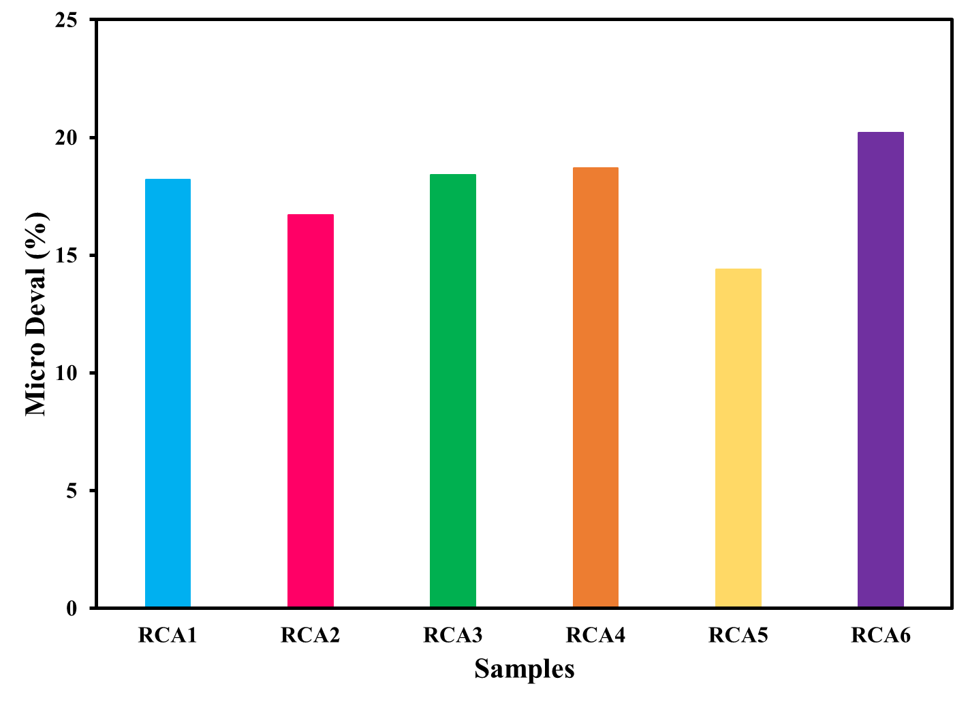
Critical parameter for long-term pavement structural integrity
NA : 27% (BNQ 2560-114/2002)
RCA : < 35% (BNQ 2002)

Slide 15
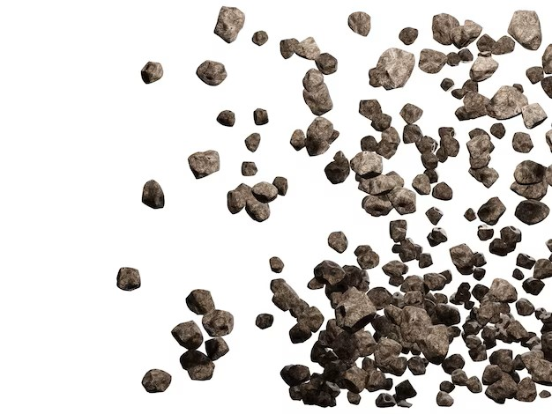





Sustainable Development Goals
- Creation of specialized employment opportunities
- 40% increase in specialized training programs
- 25-35% reduction in carbon emissions
- Decreased energy consumption in production
60% diversion rate from landfills
- Enhanced urban infrastructure resilience
- 30-40% reduction in quarrying activities
- Enhanced ecosystem preservation
40-60% reduction in virgin material demand
- Promotion of circular economy principles

Slide 16

Thank You

