Slide 1
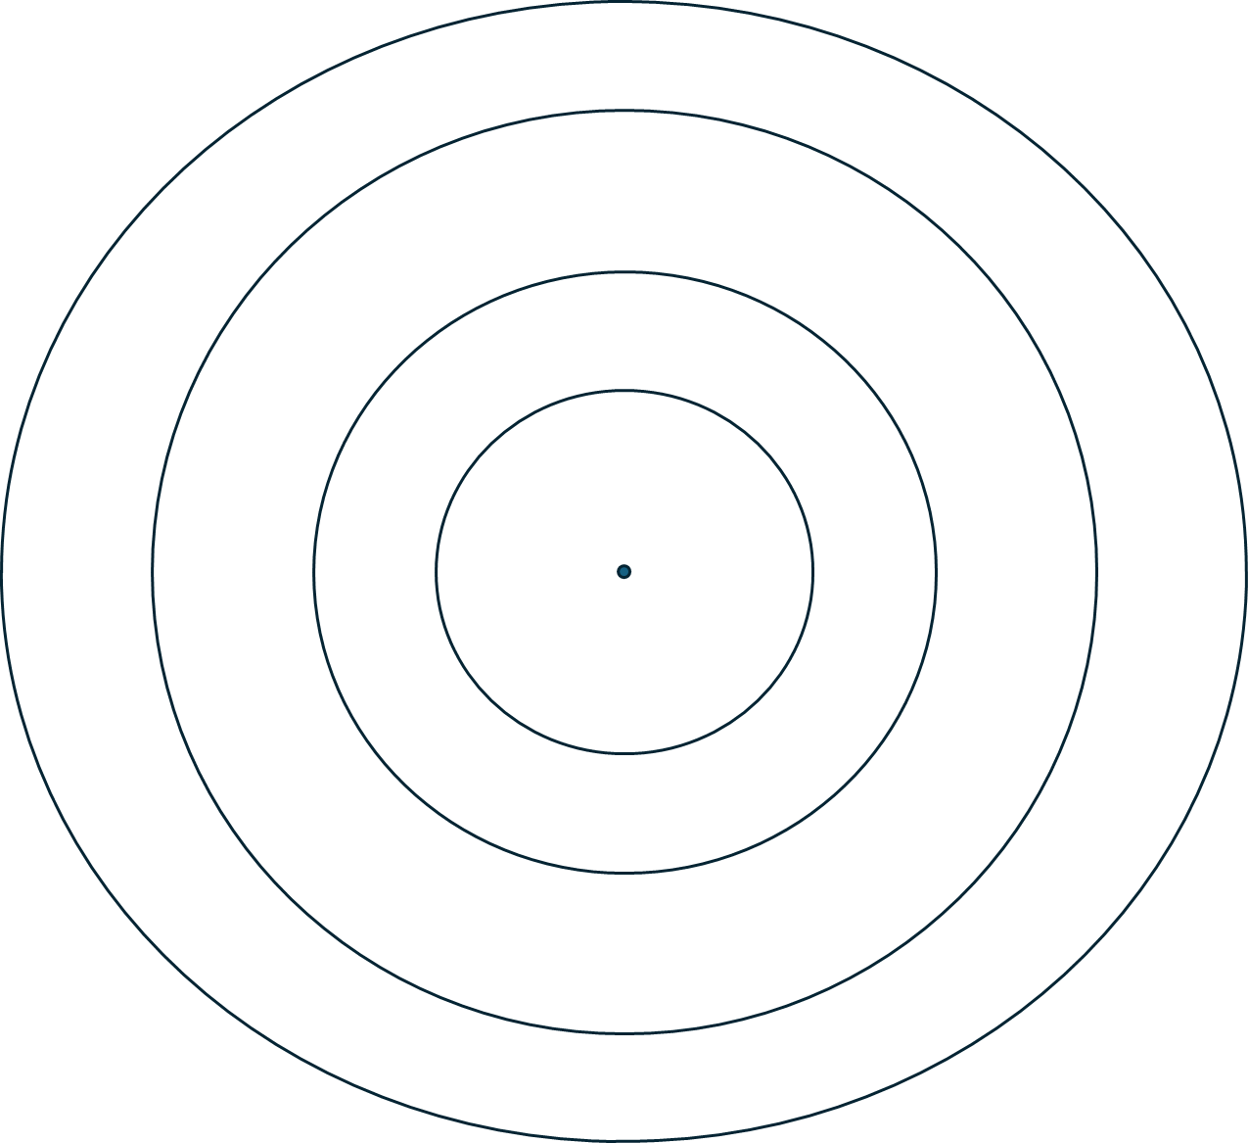
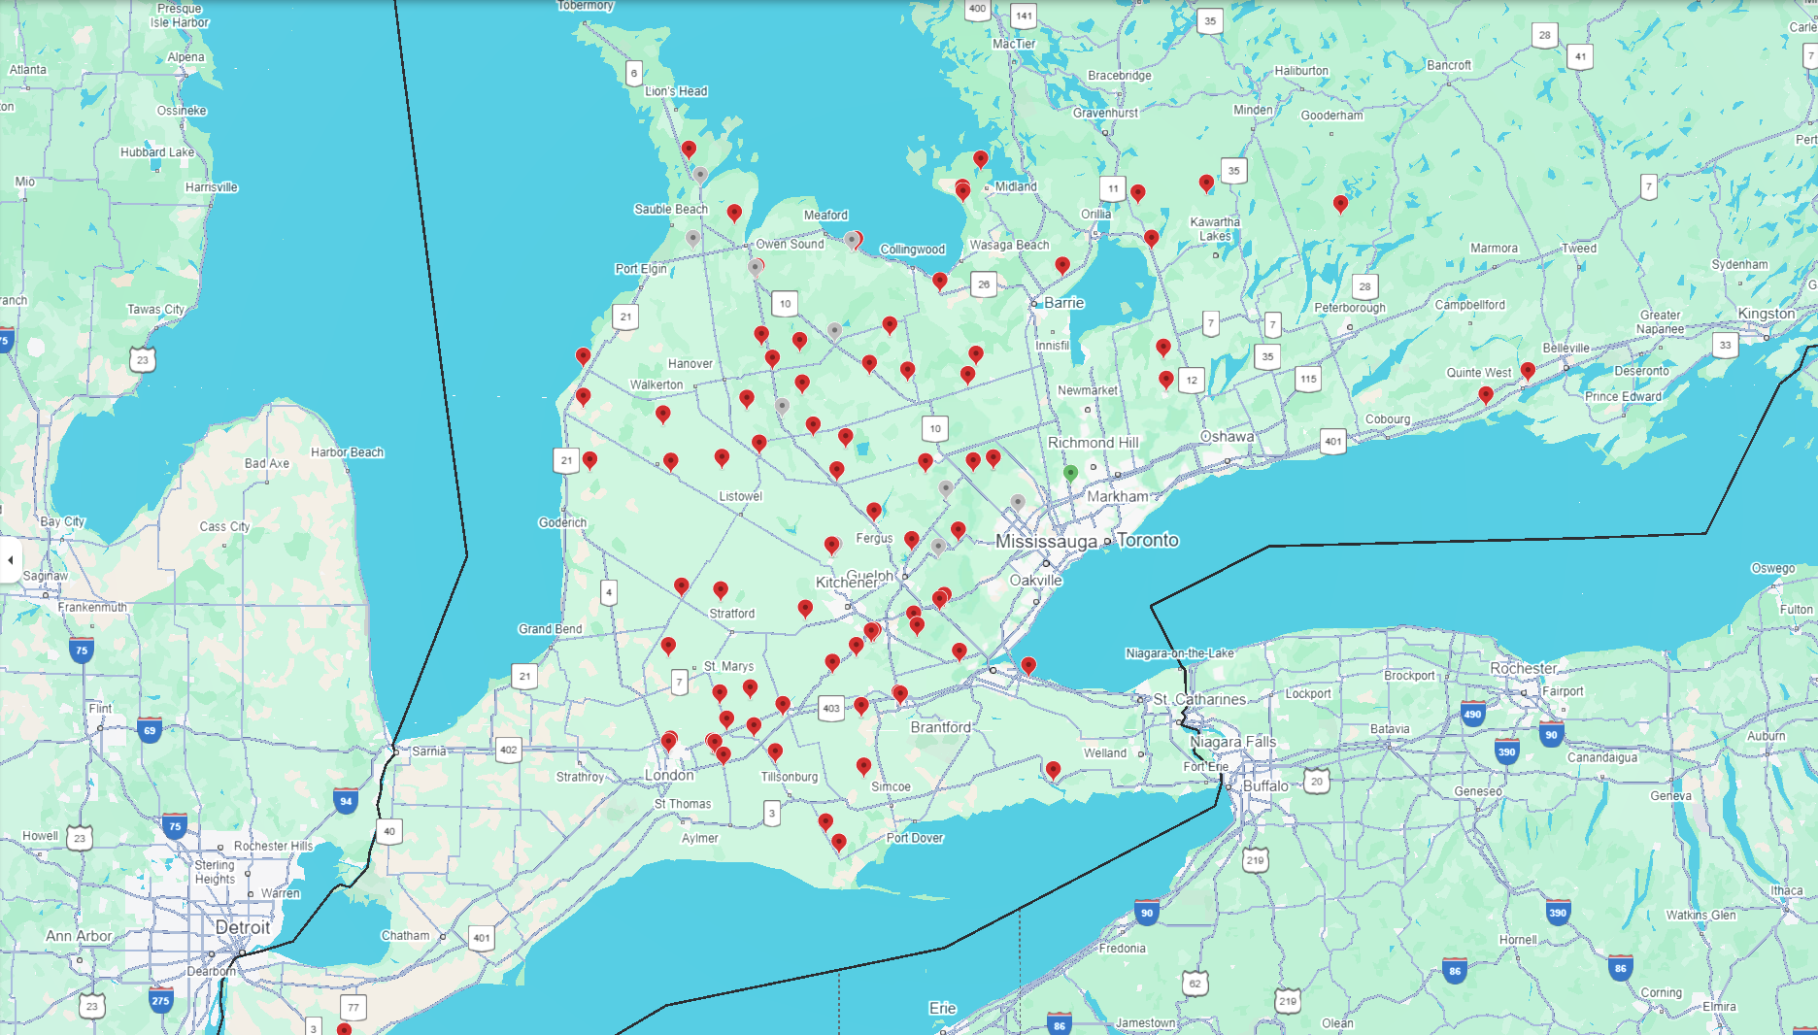
Approved Licences
2014 - 2019
50 km
100 km
150 km
200 km

Slide 2
Approved Licences
2020 - 2024
50 km
100 km
150 km
200 km

